Slide 1


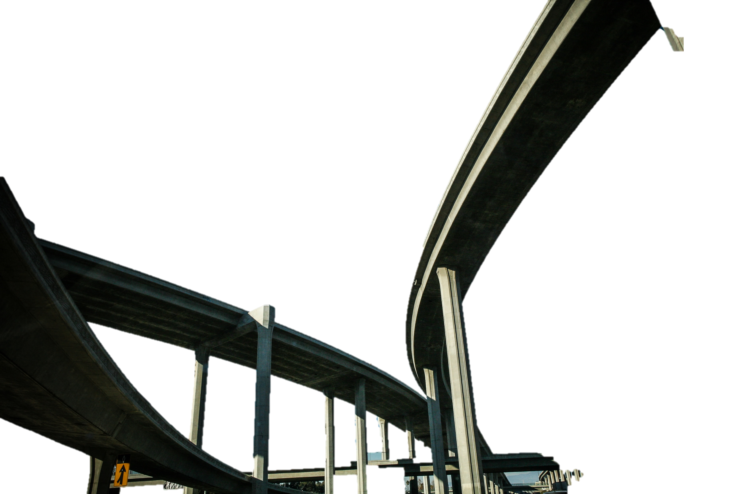
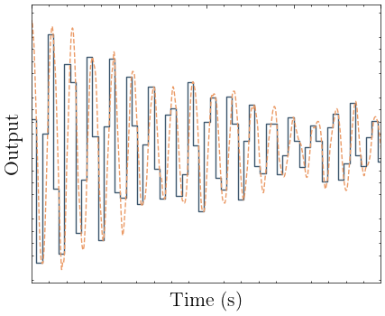
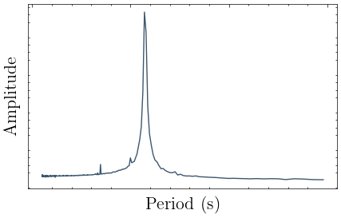
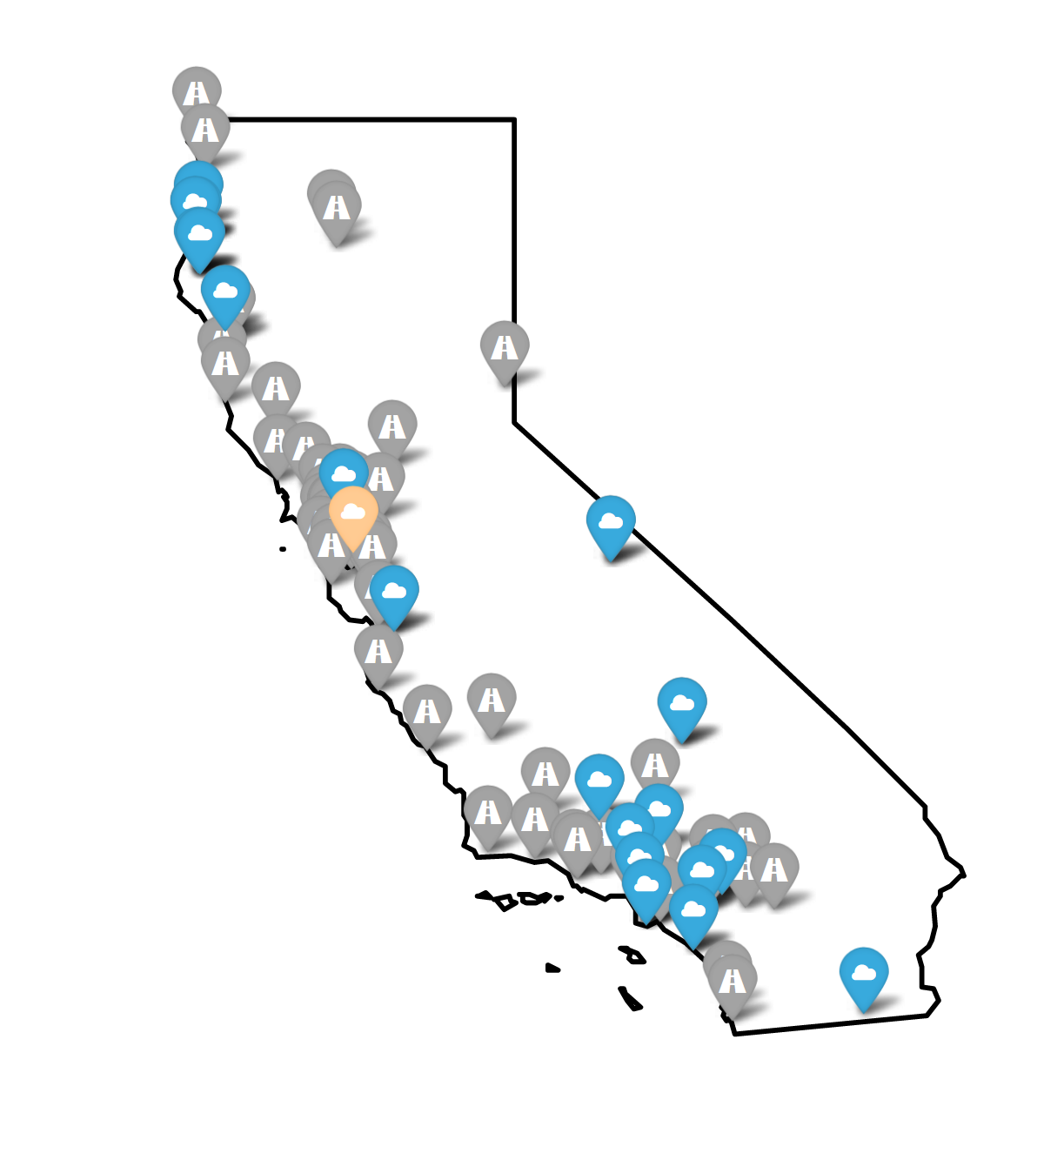
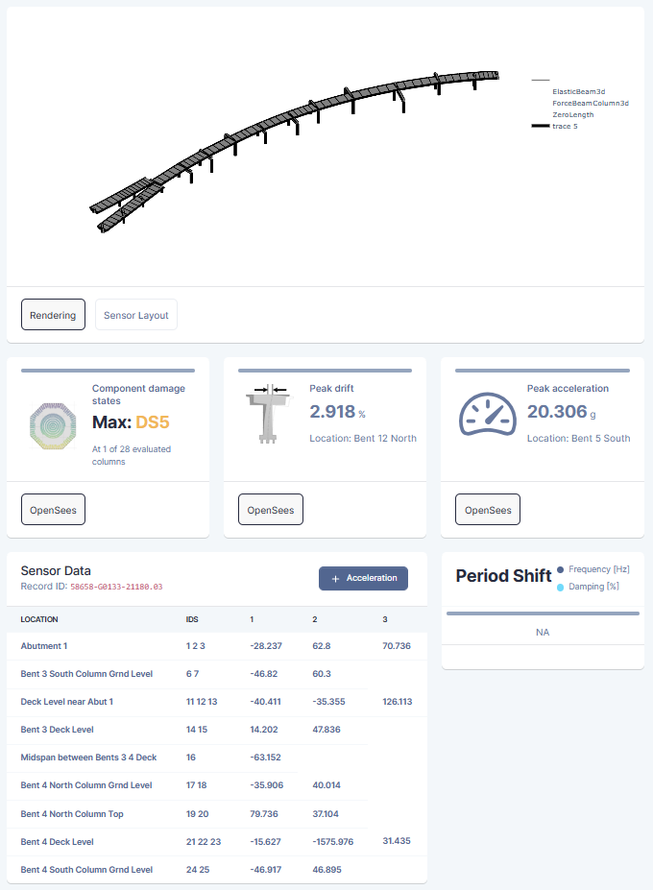
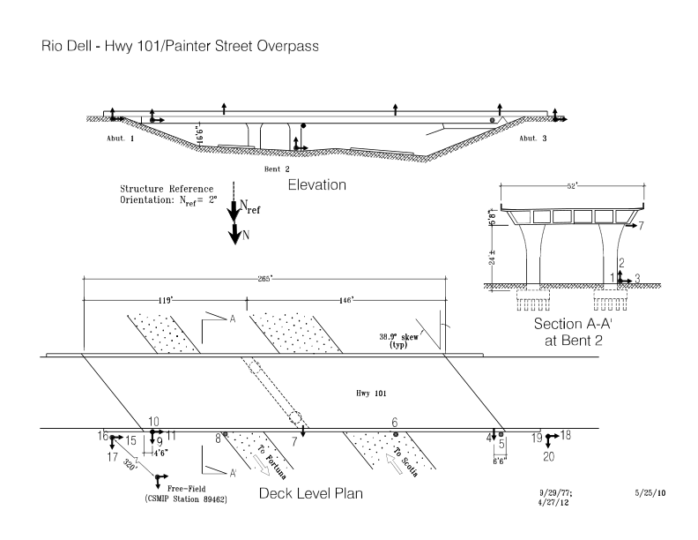
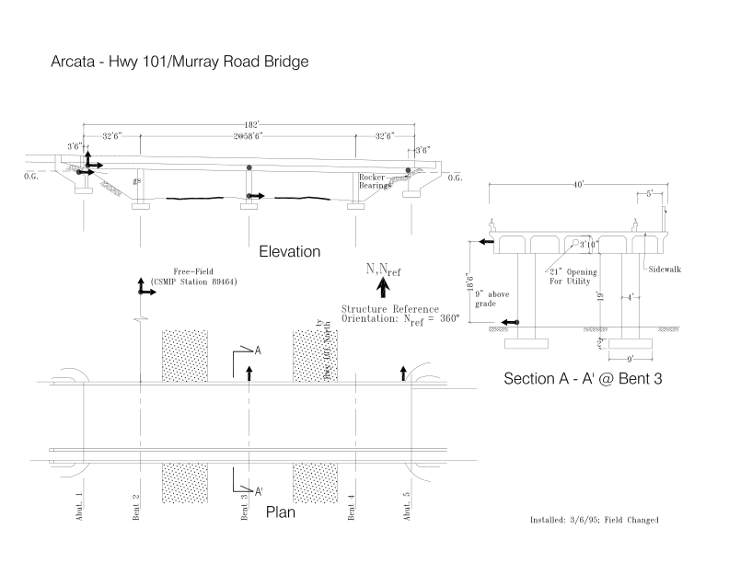
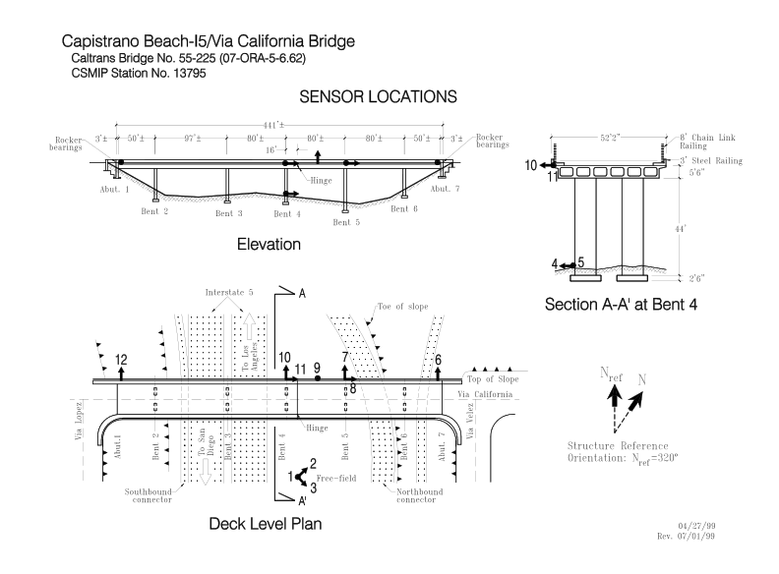
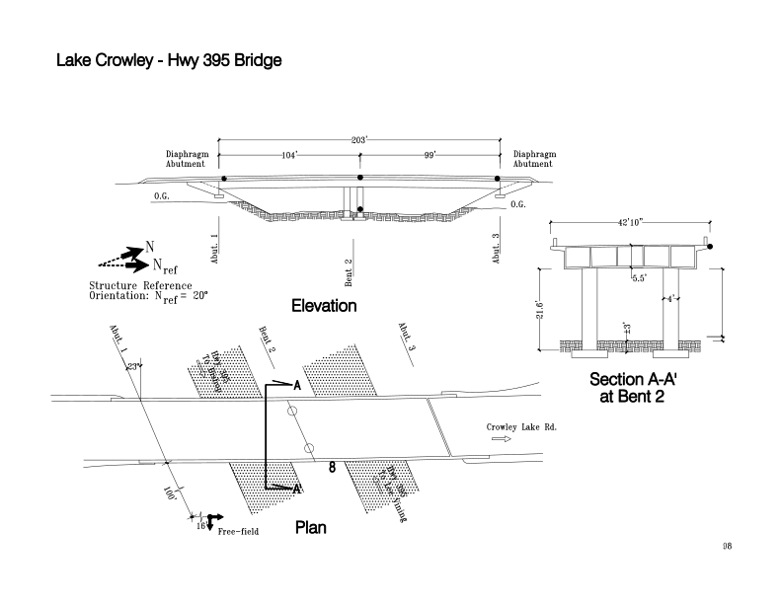
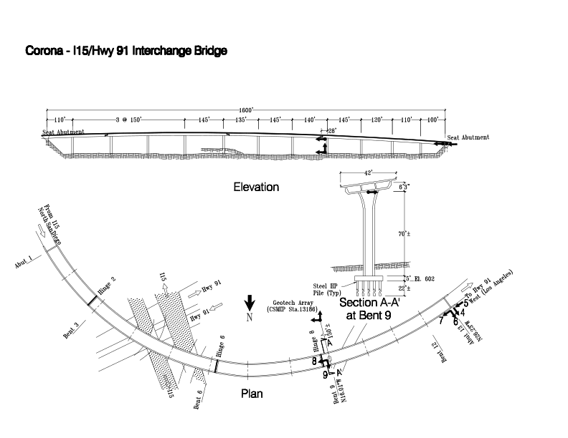
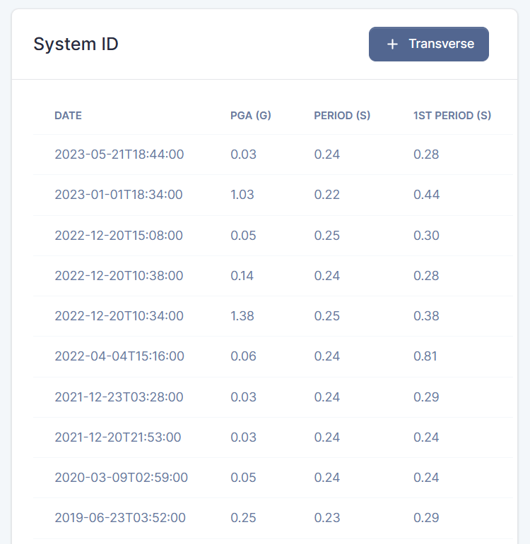
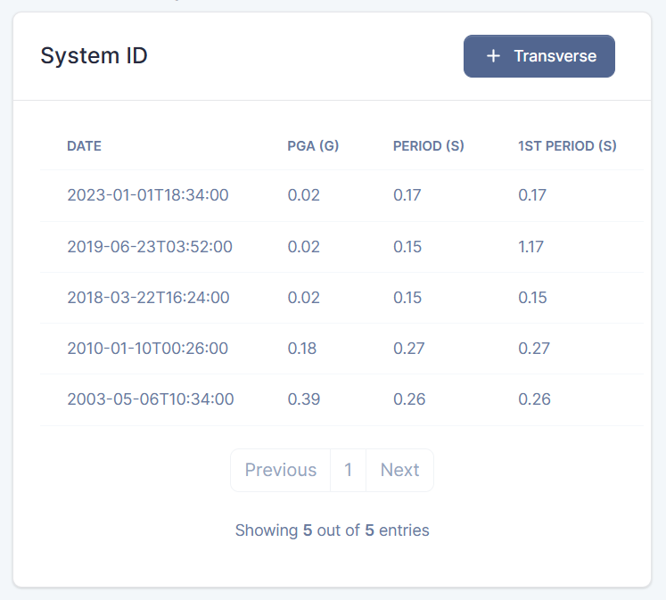
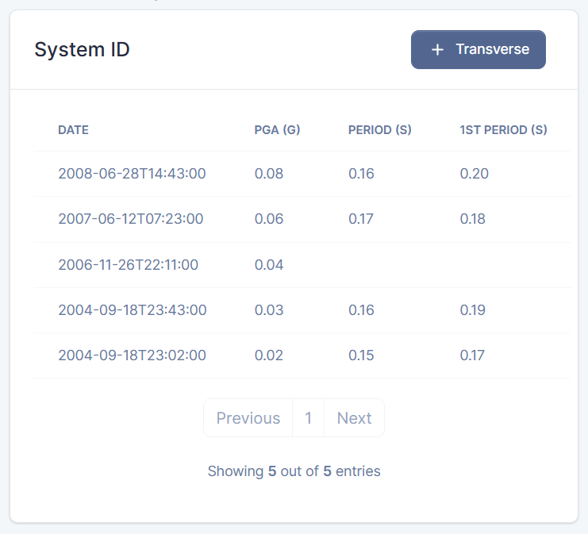
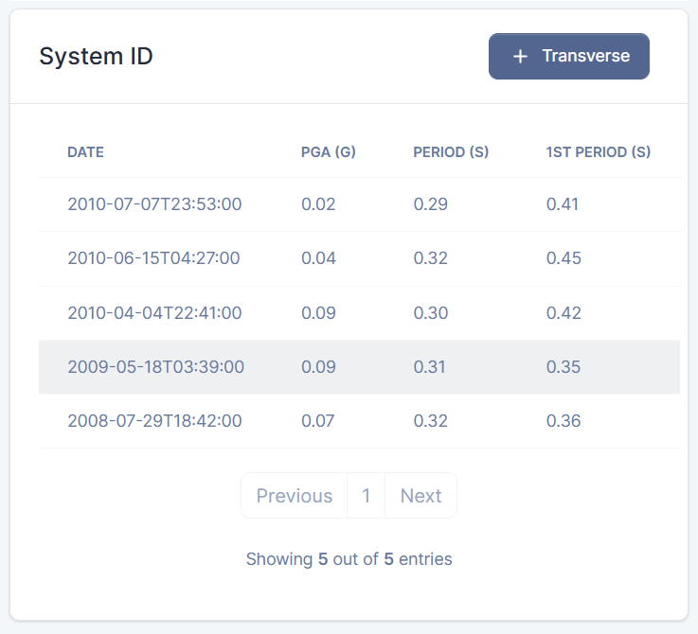
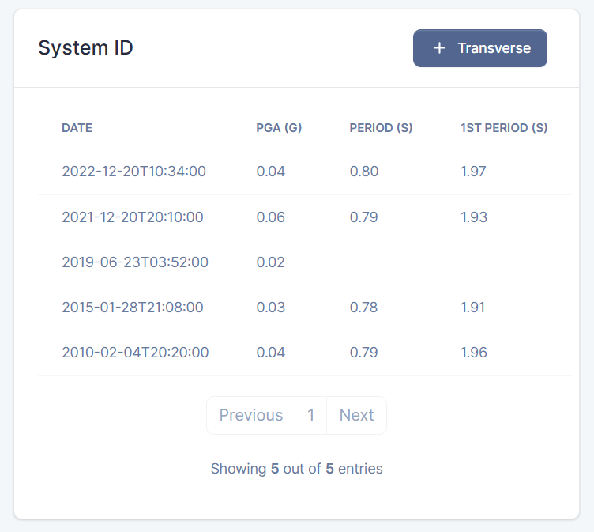

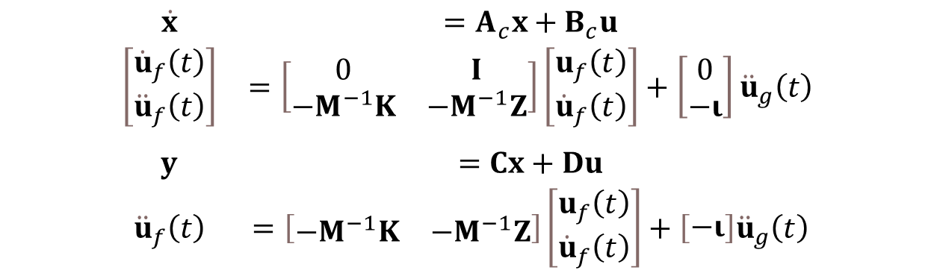
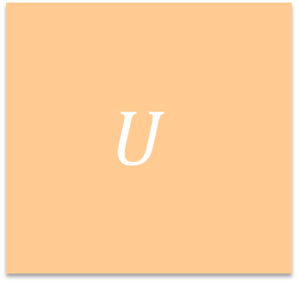




BRACE²: Bridge Rapid Assessment Center
for Extreme Events
Principal Investigator: Khalid M. Mosalam, UC Berkeley Student Investigators: Claudio Perez & Chrystal Chern, Researchers, UC Berkeley University of California Berkeley
objective: invert the conventional analysis problem
val, vec = eigid(inputs, outputs)
Two Approaches
Solution
Idea: Fit an ideal continuous system to the discrete response in the time domain.
Ho-Kalman/Eigensystem Realization Algorithm
Subspace Identification
Least Squares Methods
SRIM
State space system identification techniques such as System Realization with Information Matrix reveal the underlying fundamental dynamic system for a multi-input, multi-output, or MIMO signal.
Optimizations
A new, optimized algorithm has been developed that leverages shared memory parallelism to drastically reduce the computational demands of estimating a state space model.
Memory use has been optimized to efficiently leverage caching.
Package
All methods are accessible through the python lilo package.
lilo.eigid(inputs, outputs)
$$\begin{matrix}\begin{matrix}\dot{x} & =A_{c}x+B_{c}u \\ \left[\begin{matrix}{\dot{u}}_{f}\left(t\right) \\ {\ddot{u}}_{f}\left(t\right)\end{matrix}\right] & =\left[\begin{matrix}0 & I \\ −M^{−1}K & −M^{−1}Z\end{matrix}\right]\left[\begin{matrix}u_{f}\left(t\right) \\ {\dot{u}}_{f}\left(t\right)\end{matrix}\right]+\left[\begin{matrix}0 \\ −ι\end{matrix}\right]{\ddot{u}}_{g}\left(t\right) \\ & \\ y & =Cx+Du \\ {\ddot{u}}_{f}\left(t\right) & =\left[\begin{matrix}−M^{−1}K & −M^{−1}Z\end{matrix}\right]\left[\begin{matrix}u_{f}\left(t\right) \\ {\dot{u}}_{f}\left(t\right)\end{matrix}\right]+\left[\begin{matrix}−ι\end{matrix}\right]{\ddot{u}}_{g}\left(t\right)\end{matrix}\end{matrix}$$
Idea: Represent the system in the frequency domain.
Fourier Spectrum
Response Spectrum
Limitations
Identification methods must be scalable such that they can be applied to a growing and changing network of bridges.
High complexity systems
Frequency domain methods are ill-suited for identifying higher modes, and are limited to single-input, single-output, or SISO signals.
SVD
The singular value decomposition is heavily used in subspace and least squares methods. It is notoriously numerically intensive.
Application
$$A$$
$$=$$
$$U$$
$$Σ$$
$$V^{H}$$

Slide 2
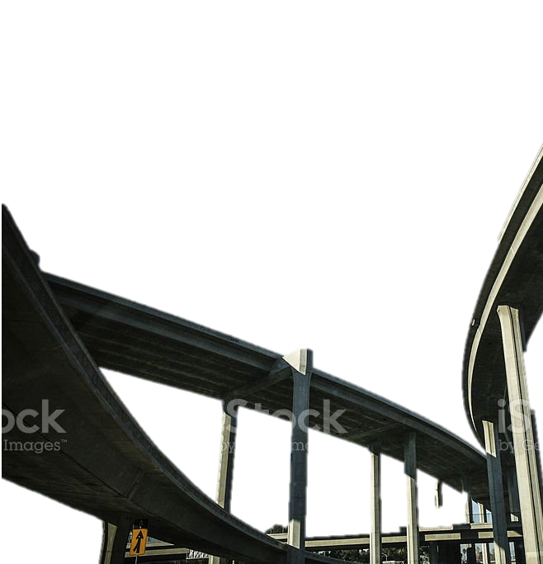
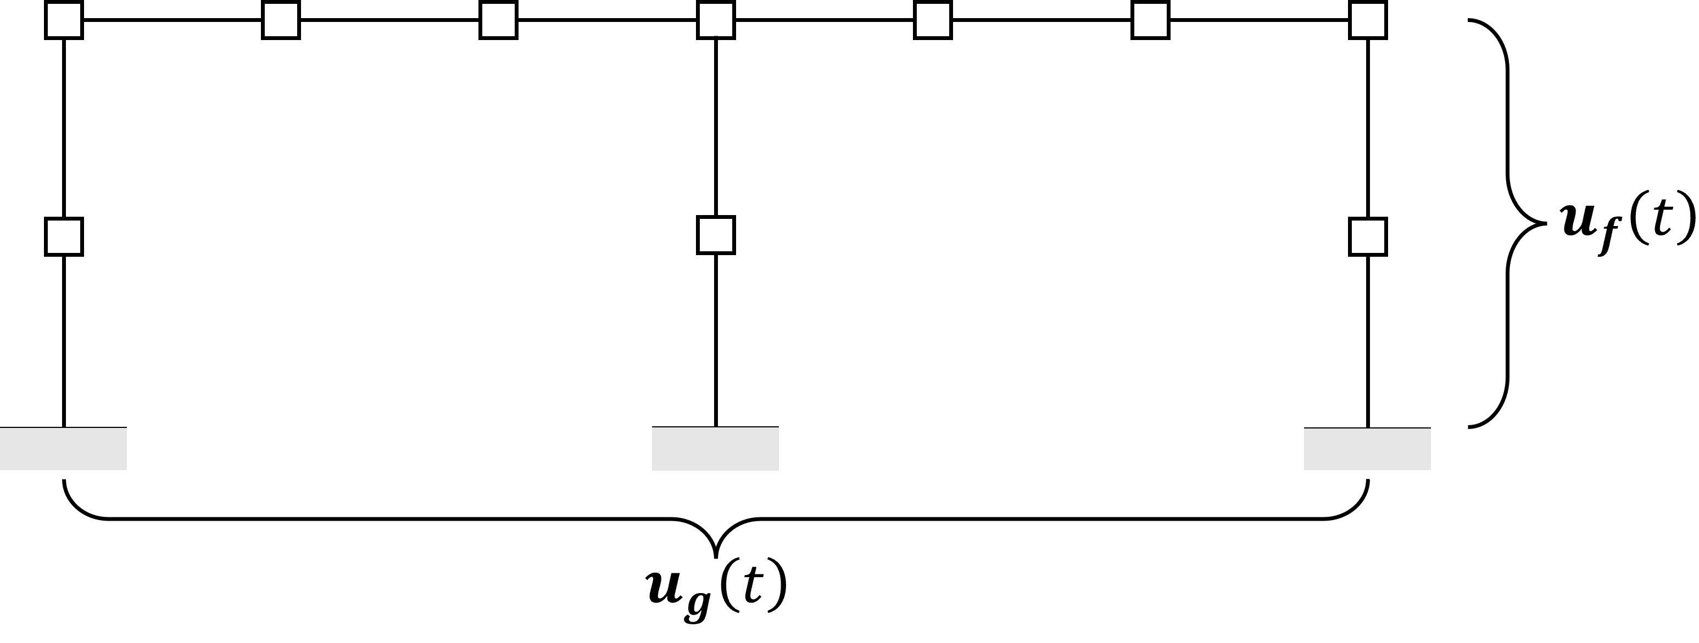



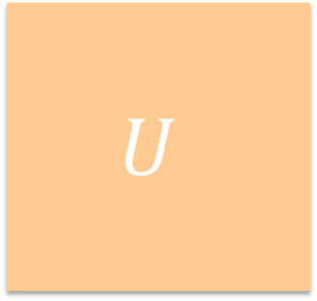

BRACE²: Bridge Rapid Assessment Center
for Extreme Events
Principal Investigator: Khalid M. Mosalam, UC Berkeley Student Investigators: Claudio Perez & Chrystal Chern, Researchers, UC Berkeley University of California Berkeley
objective: invert the conventional analysis problem
val, vec = eigid(inputs, outputs)
Two Approaches
Solution
Idea: Fit an ideal continuous system to the discrete response in the time domain.
Ho-Kalman/Eigensystem Realization Algorithm
Subspace Identification
Least Squares Methods
SRIM
State space system identification techniques such as System Realization with Information Matrix reveal the underlying fundamental dynamic system for a multi-input, multi-output, or MIMO signal.
Optimizations
A new, optimized algorithm has been developed that leverages shared memory parallelism to drastically reduce the computational demands of estimating a state space model.
Memory use has been optimized to efficiently leverage caching.
Package
All methods are accessible through the python lilo package.
lilo.eigid(inputs, outputs)
$$\begin{matrix}\begin{matrix}\dot{x} & =A_{c}x+B_{c}u \\ \left[\begin{matrix}{\dot{u}}_{f}\left(t\right) \\ {\ddot{u}}_{f}\left(t\right)\end{matrix}\right] & =\left[\begin{matrix}0 & I \\ −M^{−1}K & −M^{−1}Z\end{matrix}\right]\left[\begin{matrix}u_{f}\left(t\right) \\ {\dot{u}}_{f}\left(t\right)\end{matrix}\right]+\left[\begin{matrix}0 \\ −ι\end{matrix}\right]{\ddot{u}}_{g}\left(t\right) \\ & \\ y & =Cx+Du \\ {\ddot{u}}_{f}\left(t\right) & =\left[\begin{matrix}−M^{−1}K & −M^{−1}Z\end{matrix}\right]\left[\begin{matrix}u_{f}\left(t\right) \\ {\dot{u}}_{f}\left(t\right)\end{matrix}\right]+\left[\begin{matrix}−ι\end{matrix}\right]{\ddot{u}}_{g}\left(t\right)\end{matrix}\end{matrix}$$
Idea: Represent the system in the frequency domain.
Fourier Spectrum
Response Spectrum
Limitations
Identification methods must be scalable such that they can be applied to a growing and changing network of bridges. That is, they must require minimal modification when applied to new assets, and they must be low-cost.
Application
$$A$$
$$U$$
$$Σ$$
$$V^{H}$$
SVD
The singular value decomposition is heavily used in subspace and least squares methods. It is notoriously numerically intensive.
High complexity systems
Frequency domain methods are ill-suited for identifying higher modes, and are limited to single-input, single-output, or SISO signals.
$$=$$

Slide 3
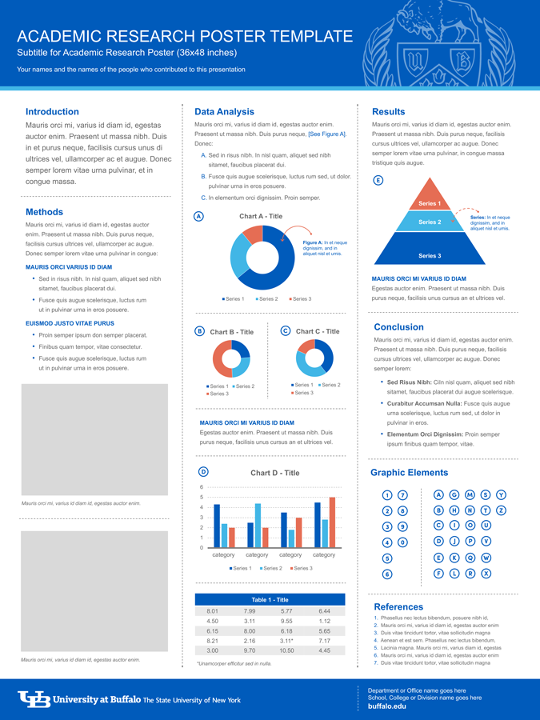






BRACE²: Bridge Rapid Assessment Center
for Extreme Events
Principal Investigator: Khalid M. Mosalam, UC Berkeley Student Investigators: Claudio Perez & Chrystal Chern, Researchers, UC Berkeley University of California Berkeley
objective: invert the conventional analysis problem
val, vec = eigid(inputs, outputs)
Two Approaches
Solution
Idea: Fit an ideal continuous system to the discrete response in the time domain.
Ho-Kalman/Eigensystem Realization Algorithm
Subspace Identification
Least Squares Methods
SRIM
State space system identification techniques such as System Realization with Information Matrix reveal the underlying fundamental dynamic system for a multi-input, multi-output, or MIMO signal.
Optimizations
A new, optimized algorithm has been developed that leverages shared memory parallelism to drastically reduce the computational demands of estimating a state space model.
Memory use has been optimized to efficiently leverage caching.
Package
All methods are accessible through the python lilo package.
lilo.eigid(inputs, outputs)
$$\begin{matrix}\begin{matrix}\dot{x} & =A_{c}x+B_{c}u \\ \left[\begin{matrix}{\dot{u}}_{f}\left(t\right) \\ {\ddot{u}}_{f}\left(t\right)\end{matrix}\right] & =\left[\begin{matrix}0 & I \\ −M^{−1}K & −M^{−1}Z\end{matrix}\right]\left[\begin{matrix}u_{f}\left(t\right) \\ {\dot{u}}_{f}\left(t\right)\end{matrix}\right]+\left[\begin{matrix}0 \\ −ι\end{matrix}\right]{\ddot{u}}_{g}\left(t\right) \\ & \\ y & =Cx+Du \\ {\ddot{u}}_{f}\left(t\right) & =\left[\begin{matrix}−M^{−1}K & −M^{−1}Z\end{matrix}\right]\left[\begin{matrix}u_{f}\left(t\right) \\ {\dot{u}}_{f}\left(t\right)\end{matrix}\right]+\left[\begin{matrix}−ι\end{matrix}\right]{\ddot{u}}_{g}\left(t\right)\end{matrix}\end{matrix}$$
Idea: Represent the system in the frequency domain.
Fourier Spectrum
Response Spectrum
Limitations
$$A$$
$$=$$
$$U$$
$$Σ$$
$$V^{H}$$
SVD
The singular value decomposition is heavily used in subspace and least squares methods. It is notoriously numerically intensive.
Application
High complexity systems
Frequency domain methods are ill-suited for identifying higher modes, and are limited to single-input, single-output, or SISO signals.
Network
Identification methods must be scalable such that they can be applied to a growing and changing network of bridges. That is, they must require minimal modification when applied to new assets, and they must be low-cost.

Slide 4
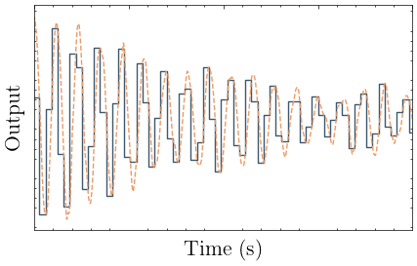
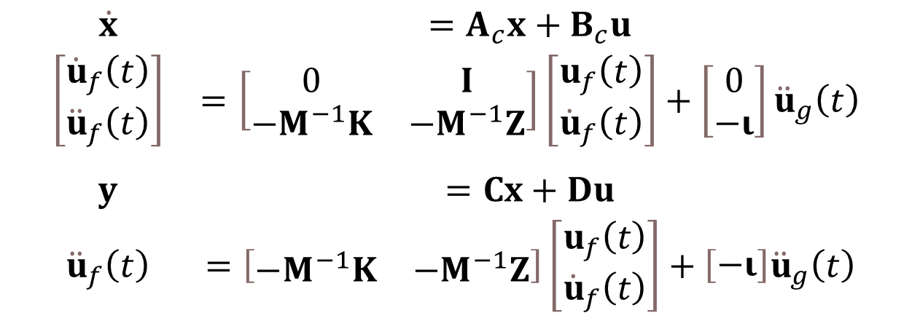
BRACE²: Bridge Rapid Assessment Center
for Extreme Events
Principal Investigator: Khalid M. Mosalam, UC Berkeley Student Investigators: Claudio Perez, Chrystal Chern, Researchers, UC Berkeley University of California Berkeley
val, vec = eigid(inputs, outputs)
Two Approaches
Solution
Idea: Fit an ideal continuous system to the discrete response in the time domain.
Ho-Kalman/Eigensystem Realization Algorithm
Subspace Identification
Least Squares Methods
State space system identification with SRIM
Parallel
lilo.eigid(inputs, outputs)
$$\begin{matrix}\begin{matrix}\dot{x} & =A_{c}x+B_{c}u \\ \left[\begin{matrix}{\dot{u}}_{f}\left(t\right) \\ {\ddot{u}}_{f}\left(t\right)\end{matrix}\right] & =\left[\begin{matrix}0 & I \\ −M^{−1}K & −M^{−1}Z\end{matrix}\right]\left[\begin{matrix}u_{f}\left(t\right) \\ {\dot{u}}_{f}\left(t\right)\end{matrix}\right]+\left[\begin{matrix}0 \\ −ι\end{matrix}\right]{\ddot{u}}_{g}\left(t\right) \\ & \\ y & =Cx+Du \\ {\ddot{u}}_{f}\left(t\right) & =\left[\begin{matrix}−M^{−1}K & −M^{−1}Z\end{matrix}\right]\left[\begin{matrix}u_{f}\left(t\right) \\ {\dot{u}}_{f}\left(t\right)\end{matrix}\right]+\left[\begin{matrix}−ι\end{matrix}\right]{\ddot{u}}_{g}\left(t\right)\end{matrix}\end{matrix}$$
Idea: Represent the system in the frequency domain.
Fourier Spectrum
Response Spectrum
Limitations
Application

Slide 5

BRACE²: Bridge Rapid Assessment Center
for Extreme Events
Principal Investigator: Khalid M. Mosalam, UC Berkeley Student Investigators: Claudio Perez, Chrystal Chern, Researchers, UC Berkeley University of California Berkeley
val, vec = eigid(inputs, outputs)
Two Approaches
Solution
Idea: Fit an ideal continuous system to the discrete response in the time domain.
Ho-Kalman/Eigensystem Realization Algorithm
Subspace Identification
Least Squares Methods
State space system identification with SRIM
Parallel
lilo.eigid(inputs, outputs)
$$\begin{matrix}\begin{matrix}\dot{x} & =A_{c}x+B_{c}u \\ \left[\begin{matrix}{\dot{u}}_{f}\left(t\right) \\ {\ddot{u}}_{f}\left(t\right)\end{matrix}\right] & =\left[\begin{matrix}0 & I \\ −M^{−1}K & −M^{−1}Z\end{matrix}\right]\left[\begin{matrix}u_{f}\left(t\right) \\ {\dot{u}}_{f}\left(t\right)\end{matrix}\right]+\left[\begin{matrix}0 \\ −ι\end{matrix}\right]{\ddot{u}}_{g}\left(t\right) \\ & \\ y & =Cx+Du \\ {\ddot{u}}_{f}\left(t\right) & =\left[\begin{matrix}−M^{−1}K & −M^{−1}Z\end{matrix}\right]\left[\begin{matrix}u_{f}\left(t\right) \\ {\dot{u}}_{f}\left(t\right)\end{matrix}\right]+\left[\begin{matrix}−ι\end{matrix}\right]{\ddot{u}}_{g}\left(t\right)\end{matrix}\end{matrix}$$
Idea: Represent the system in the frequency domain.
Fourier Spectrum
Response Spectrum
Limitations
Application

Slide 6
BRACE²: Bridge Rapid Assessment Center
for Extreme Events
Principal Investigator: Khalid M. Mosalam, UC Berkeley Student Investigators: Claudio Perez, Chrystal Chern, Researchers, UC Berkeley University of California Berkeley
val, vec = eigid(inputs, outputs)
Two Approaches
Solution
Idea: Fit an ideal continuous system to the discrete response in the time domain.
Ho-Kalman/Eigensystem Realization Algorithm
Subspace Identification
Least Squares Methods
State space system identification with SRIM
Parallel
lilo.eigid(inputs, outputs)
$$\begin{matrix}\begin{matrix}\dot{x} & =A_{c}x+B_{c}u \\ \left[\begin{matrix}{\dot{u}}_{f}\left(t\right) \\ {\ddot{u}}_{f}\left(t\right)\end{matrix}\right] & =\left[\begin{matrix}0 & I \\ −M^{−1}K & −M^{−1}Z\end{matrix}\right]\left[\begin{matrix}u_{f}\left(t\right) \\ {\dot{u}}_{f}\left(t\right)\end{matrix}\right]+\left[\begin{matrix}0 \\ −ι\end{matrix}\right]{\ddot{u}}_{g}\left(t\right) \\ & \\ y & =Cx+Du \\ {\ddot{u}}_{f}\left(t\right) & =\left[\begin{matrix}−M^{−1}K & −M^{−1}Z\end{matrix}\right]\left[\begin{matrix}u_{f}\left(t\right) \\ {\dot{u}}_{f}\left(t\right)\end{matrix}\right]+\left[\begin{matrix}−ι\end{matrix}\right]{\ddot{u}}_{g}\left(t\right)\end{matrix}\end{matrix}$$
Idea: Represent the system in the frequency domain.
Fourier Spectrum
Response Spectrum
Limitations
Application

